Slide 1

Data Science
Decision Tree

Slide 2
Decision Trees (DT)
A Decision Tree is a supervised machine learning algorithm used for both classification and regression tasks.
It works by splitting the dataset into subsets based on feature values in a tree-like structure. Each internal node represents a decision on an attribute, each branch represents the outcome of the decision, and each leaf node represents a class label (in classification) or a value (in regression).
Decision Trees use measures like Gini Index, Entropy (Information Gain), or Variance Reduction to determine the best split at each node.

Slide 3
Example
ID | Outlook | Temperature | Humidity | Wind | PlayTennis
1 | Sunny | Hot | High | Weak | No
2 | Sunny | Hot | High | Strong | No
3 | Overcast | Hot | High | Weak | Yes
4 | Rain | Mild | High | Weak | Yes
5 | Rain | Cool | Normal | Weak | Yes
6 | Rain | Cool | Normal | Strong | No
7 | Overcast | Cool | Normal | Strong | Yes
8 | Sunny | Mild | High | Weak | No
9 | Sunny | Cool | Normal | Weak | Yes
10 | Rain | Mild | Normal | Weak | Yes

Slide 4

Step 1: Calculate Root Entropy
We have:
PlayTennis = Yes: 6
PlayTennis = No: 4

Slide 5
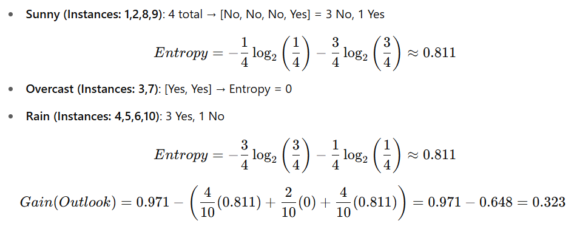
Step 2: Compute Information Gain for each feature
Feature: Outlook

Slide 6
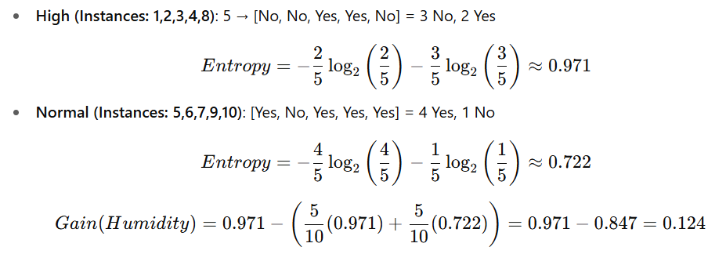
Feature: Humidity

Slide 7
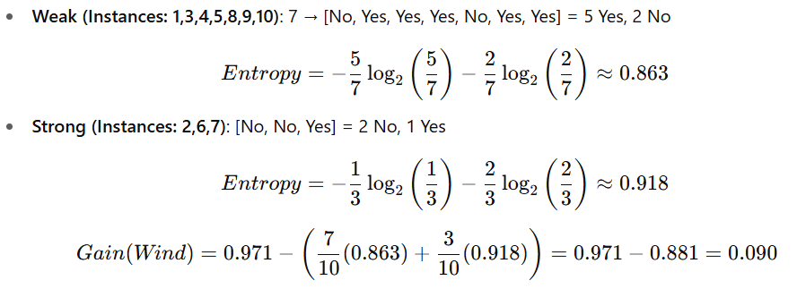
Feature: Wind

Slide 8
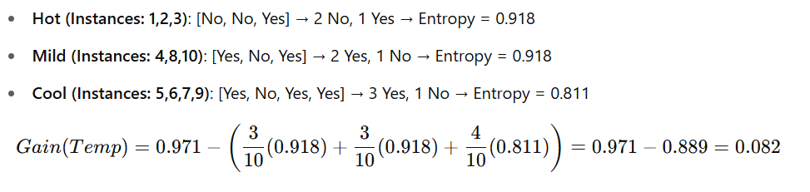
Feature: Temperature

Slide 9
Step 3: Select Feature with Max Gain
Outlook: 0.323
Humidity: 0.124
Wind: 0.090
Temp: 0.082
So we split first on Outlook
Outlook
Sunny
Overcast
Rain
Subtree
Yes
Subtree

Slide 10

New Dataset (Expand: Sunny branch)
Step 1: Filter the dataset where Outlook = Sunny
ID | Outlook | Temp | Humidity | Wind | PlayTennis
1 | Sunny | Hot | High | Weak | No
2 | Sunny | Hot | High | Strong | No
8 | Sunny | Mild | High | Weak | No
9 | Sunny | Cool | Normal | Weak | Yes
Class counts: Yes = 1, No = 3 Entropy(S) =

Slide 11
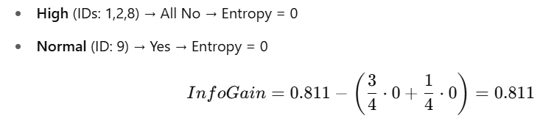
Compute Information Gain on this subset
Feature: Humidity

Slide 12
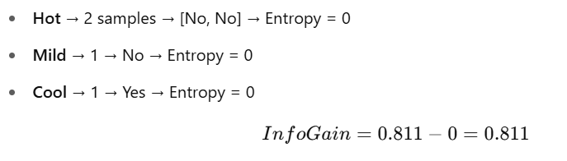
Feature: Temperature

Slide 13
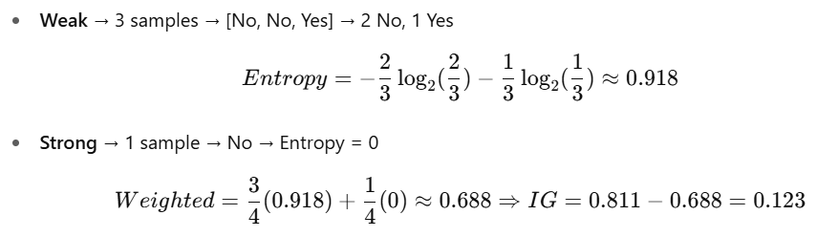
Feature: Wind
Choose Humidity or Temperature (both have IG = 0.811). Let’s pick Humidity

Slide 14
Updated Tree
Outlook
Sunny
Overcast
Rain
Humidity
Yes
Subtree?
High
Normal
No
Yes

Slide 15

Subtree (Expand: Rain branch)
Filter the dataset where Outlook = Rain
ID | Outlook | Temperature | Humidity | Wind | PlayTennis
4 | Rain | Mild | High | Weak | Yes
5 | Rain | Cool | Normal | Weak | Yes
6 | Rain | Cool | Normal | Strong | No
10 | Rain | Mild | Normal | Weak | Yes
Class counts: Yes = 3, No = 1 Entropy =

Slide 16
Compute IG on this Rain subset
Feature: Wind
Weak (IDs: 4,5,10) → All Yes → Entropy = 0
Strong (ID 6) → No → Entropy = 0
IG=0.811−0=0.811IG = 0.811 - 0 = 0.811IG=0.811−0=0.811
Best: Wind

Slide 17
Final Decision Tree
Outlook
Sunny
Overcast
Rain
Humidity
Yes
Wind
High
Normal
Weak
Strong
No
Yes
Yes
Yes

Slide 18
Pros and Cons
Pros:
Interpretable and easy to visualize
Requires minimal preprocessing
Works for both classification & regression
Captures non-linear relationships
Can handle feature interactions well
Cons:
Overfitting (especially if not pruned)
Sensitive to small changes in data
Greedy nature may miss global optimum
Biased with imbalanced datasets
Can grow very complex

Slide 19
Practice
ID | Age Group | Income | Student | Credit Rating | Loan Approved
1 | Young | High | No | Fair | No
2 | Young | High | No | Excellent | No
3 | Middle-aged | High | No | Fair | Yes
4 | Senior | Medium | No | Fair | Yes
5 | Senior | Low | Yes | Fair | Yes
6 | Senior | Low | Yes | Excellent | No
7 | Middle-aged | Low | Yes | Excellent | Yes
8 | Young | Medium | No | Fair | No
9 | Young | Low | Yes | Fair | Yes
10 | Senior | Medium | Yes | Fair | Yes
11 | Young | Medium | Yes | Excellent | Yes
12 | Middle-aged | Medium | No | Excellent | Yes
13 | Middle-aged | High | Yes | Fair | Yes
14 | Senior | Medium | No | Excellent | No

